Slide 1

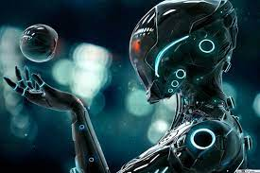
ROBOTICS
2200032650 -CHARITHA
ROBOTICS
31053 -RAJESWARI
ROBOTIC HISTORY
2200030451-JAHNAVI
TYPES OF ROBOTS
2200030022-PUJITHA
ROBOTIC PARTS
2200030493-GEETHIKA
ADVANTAGES AND DISADVANTAGES
CONCLUSION
2200030022-PUJITHA
ROBOTIC TECHNOLOGY
31053 -RAJESWARI
ROBOTIC HISTORY

Slide 2

ROBOTICS
WHAT IS ROBOT?
.
.
.
.
.
.
ROBOTICS
WHY ROBOTICS NEEDED

Slide 3
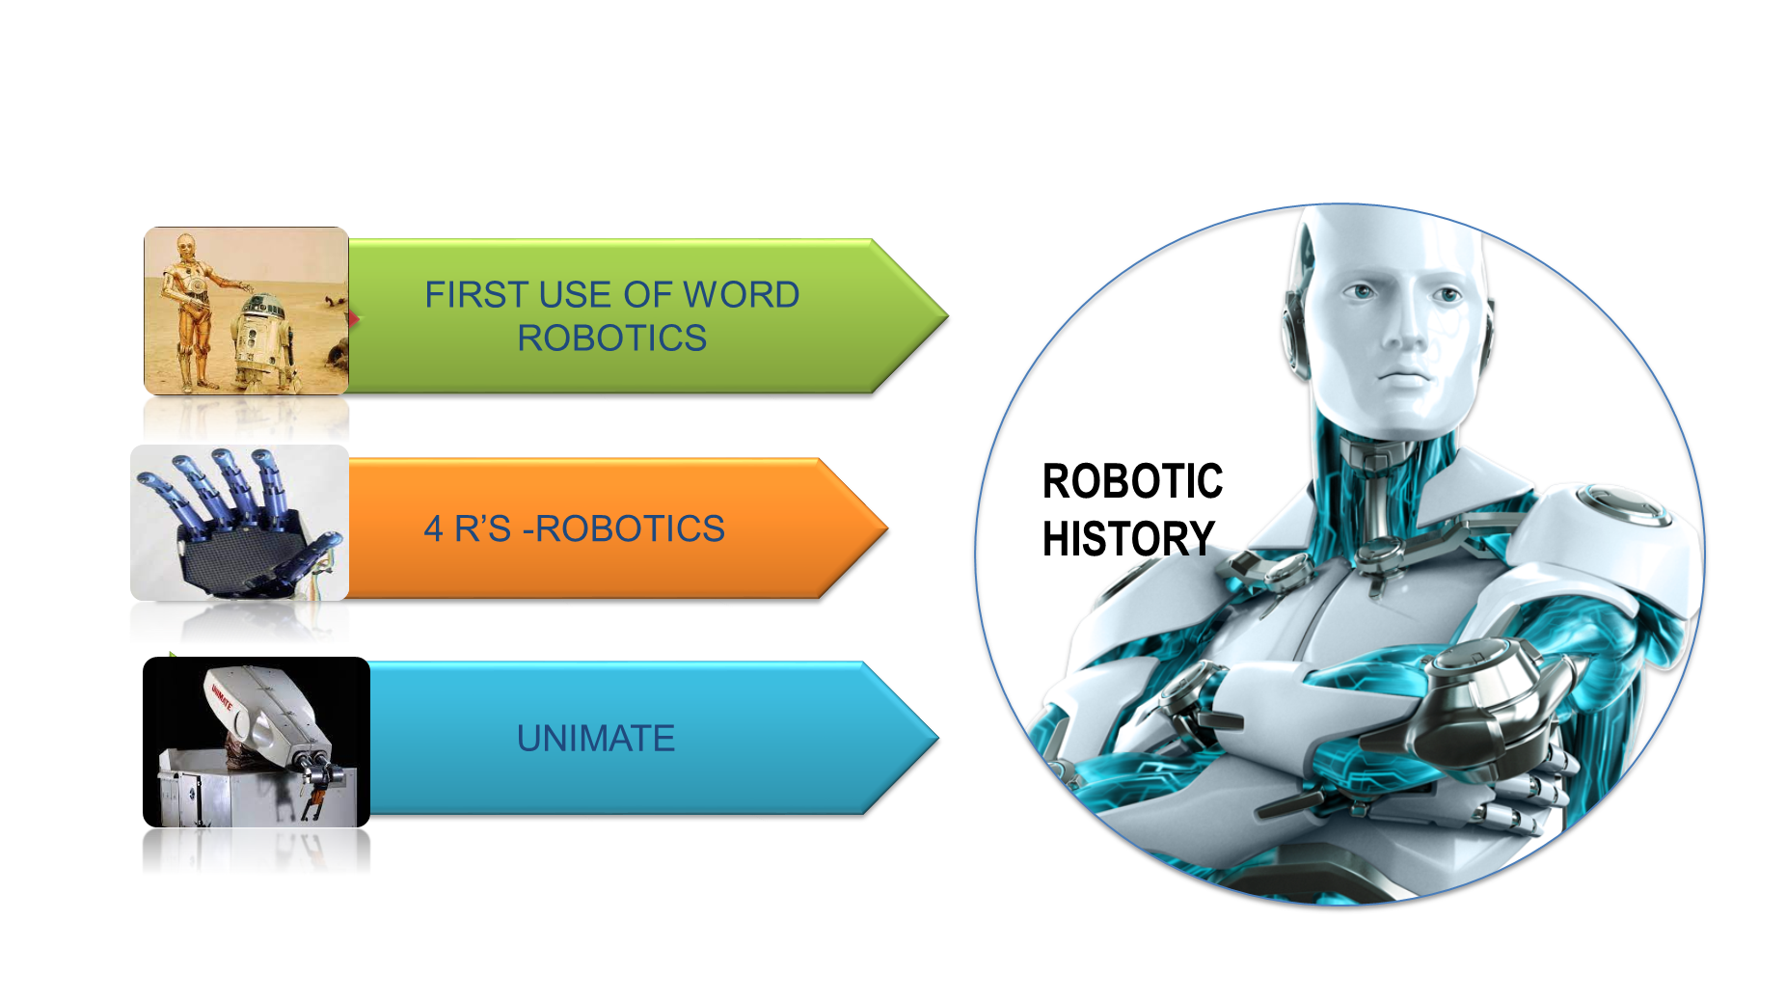

.

Slide 4

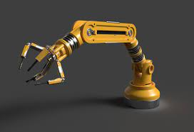
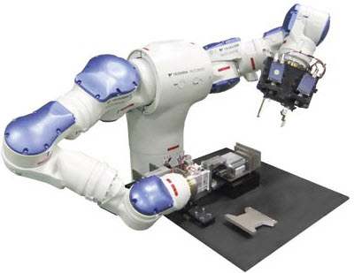
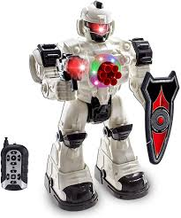
TYPES OF ROBOTS
STATIONARY ROBOTS
AUTONOMOUS ROBOTS
REMOTE CONTROLLED ROBOTS

Slide 5

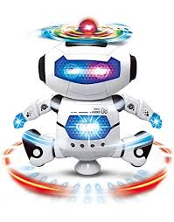
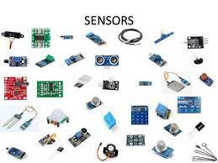
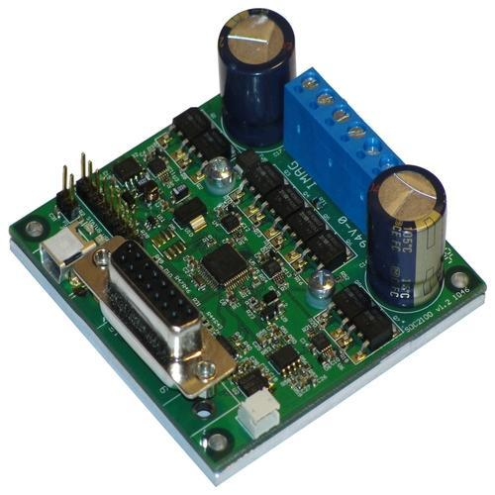
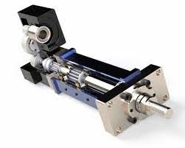
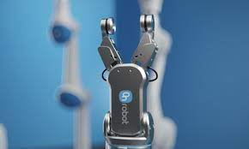
ROBOTIC TECHNOLGY
ROBOTIC TECHNOLGY
SENSORS
CONTROLLERS
ACTUATORS
EFFECTORS
SENSORS
CONTROLLERS
ACTUATORS
EFFECTORS

Slide 6

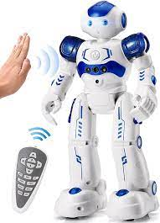
ADVANTAGES AND DISADVANTAGES
ADVANTAGES AND DISADVANTAGES
INFORMATION 24/7
INFORMATION 24/7
MONEY
MONEY
ACCURACY
POWER SUPPLY
ACCURACY
POWER SUPPLY
SPEED
NO WORK FOR HUMAN
SPEED
NO WORK FOR HUMAN

